Slide 1


21EC81P : AMCPBL Phase III Presentation
Implement a Colpitts oscillator at 150 kHz, then feed its output to a summing amplifier with gain –10. Measure: Oscillation frequency, summed/amplified output, and distortion.
Amrut R - 1RV24EC025
Anurag – 1RV24EC031
Bhavesh - 1RV24ECO44
Guide Name: Sreevidya P
Designation: Assistant Prof
Department of Electronics and Communication Engineering
*
Department of ECE
1

Slide 2
CONTENTS
INTRODUCTION
PROBLEM STATEMENT
OBJECTIVES
METHODOLOGY WITH DESIGN SPECIFICATIONS
CIRCUIT DESIGN
TOOLS AND SOFTWARE USED
LITREATURE REVIEW
*
Department of ECE
2

Slide 3
INTRODUCTION
What is the Project? This project involves the design, implementation, and analysis of two fundamental analog building blocks: a high-frequency sine wave generator (Colpitts Oscillator) and a precise signal conditioner (Inverting Summing Amplifier).
Context: Analog circuits are the foundation for all signal processing, communication systems, and timing circuits. This experiment provides hands-on validation of feedback, gain, and frequency stability concepts.
Key Components: The experiment relies on the NPN Transistor (CL100S) for active gain/feedback and an Op-Amp (implied, for the summing amplifier) for high-precision arithmetic operations.
*
Department of ECE
3

Slide 4
PROBLEM STATEMENT
“Implement a Colpitts oscillator at 150 kHz, then feed its output to a summing amplifier with gain –10. Measure: Oscillation frequency, summed/amplified output, and distortion.”
The core challenge is two-fold:
Oscillation Stability: Designing the Colpitts circuit to achieve stable, sinusoidal oscillation exactly at 150 kHz, and ensuring the BJT provides sufficient gain to sustain the oscillation (Barkhausen criterion).
Signal Conditioning: Accurately configuring a second-stage amplifier to apply a precise gain of -10 to the oscillator's output signal.
Measurement & Analysis: Verifying the circuit's performance by measuring the actual frequency, assessing the signal quality (distortion), and confirming the final amplified output voltage swing.
*
Department of ECE
4

Slide 5
OBJECTIVES
Design and Implement: Design and construct a Colpitts Oscillator using the NPN BJT and a parallel LC tank circuit to generate a sine wave at the target frequency of 150 kHz.
Verify Frequency: Precisely measure the output frequency using an Oscilloscope and confirm its deviation from the 150 kH design target.
Design and Implement Gain Stage: Design and construct an Inverting Summing Amplifier circuit (using an Op-Amp) with a stable and verified voltage gain of A_v = -10.
Analyze Output Quality: Measure and analyze the final summed/amplified output signal, paying close attention to any signal distortion (clipping or non-linearity) introduced by the BJT or the amplifier.
*
Department of ECE
5

Slide 6
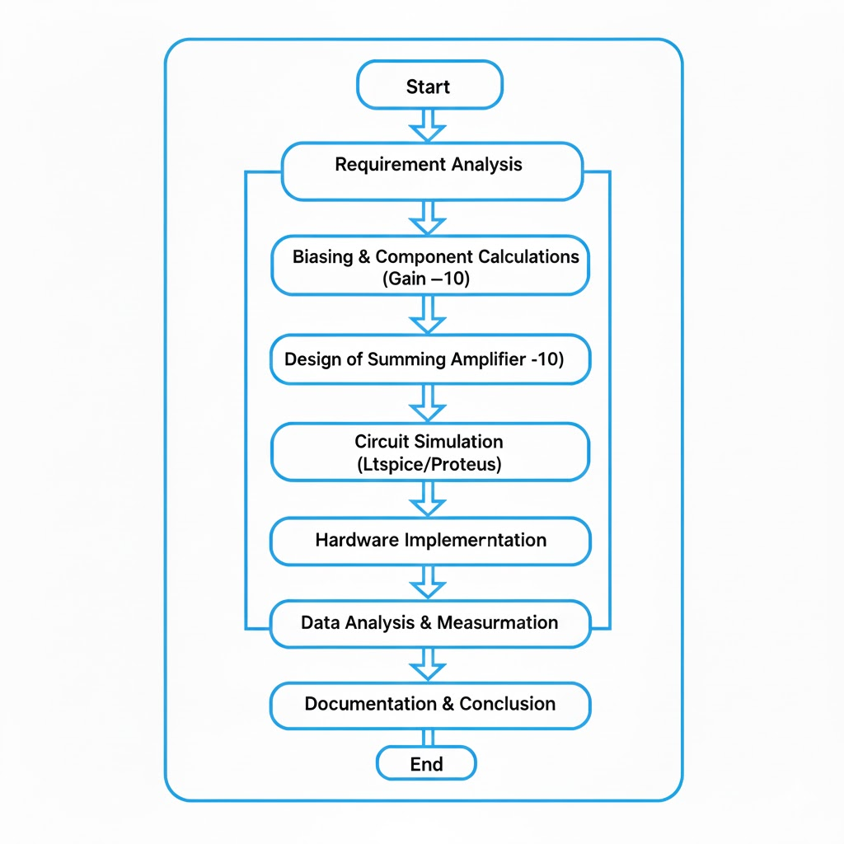
DESIGN METHODOLOGY
*
Department of ECE
6

Slide 7
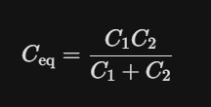
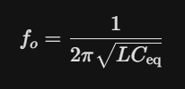
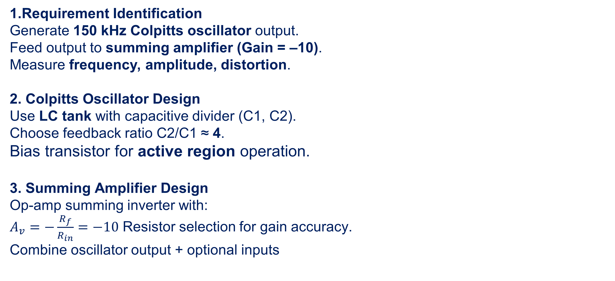
METHODOLOGY WITH DESIGN SPECIFICATIONS
1.Requirement Identification
Generate 150 kHz Colpitts oscillator output.
Feed output to summing amplifier (Gain = –10).
Measure frequency, amplitude, distortion.
2. Colpitts Oscillator Design
Use LC tank with capacitive divider (C1, C2).
Choose feedback ratio C2/C1 ≈ 4.
Bias transistor for active region operation.
3. Summing Amplifier Design
Op-amp summing inverter with:
$A_{v}=−\frac{R_{f}}{R_{in}}=−10$ Resistor selection for gain accuracy.
Combine oscillator output + optional inputs
*
Department of ECE
7

Slide 8
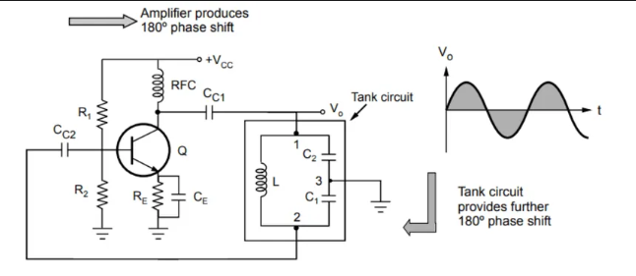
METHODOLOGY WITH DESIGN SPECIFICATIONS
Simulation & Verification
Simulate in LTspice to verify:
  Startup oscillation 150 kHz frequency
  Summing amplifier gain
5. Hardware Implementation
Build circuits on breadboard/PCB.
Minimize stray capacitance & noise.
Validate oscillation and amplifier output using DSO.
6. Measurement & Analysis
Measure frequency, amplitude, summed output, THD.
Compare measured results with theoretical design.
*
Department of ECE
8

Slide 9
DESIGN OF THE OSCILLATOR CIRCUIT
1. Transistor Configuration & Biasing
Active Element: CL100S NPN Medium Power Transistor.
Biasing Scheme: Voltage Divider Bias.
  Rationale: Provides high stability against variations in Transistor Gain and temperature.
  Operating Point: Sets Emitter current to approximately, placing the transistor in the linear active region for maximum transconductance.
2. Tank Circuit Design (150 kHz Resonance)
Inductor: Axial Inductor.
  Selection: Chosen for a higher Quality Factor at compared to larger alternatives which suffer from high internal resistance.
Capacitor : Ceramic.
Capacitor : (Implemented as in parallel).
  Selection: A ratio ensures robust feedback to the emitter, satisfying the Barkhausen Criterion for self-starting oscillations on a breadboard.
*
Department of ECE
9

Slide 10
DESIGN OF THE OSCILLATOR CIRCUIT
3. Supplementary Components
Collector Choke (RFC): Inductor.
  Role: Acts as a high-impedance load for the AC signal (blocking it from the power rail) while allowing DC current to power the collector with minimal voltage drop.
Coupling Capacitor: .
  Role: Blocks DC offset while passing the carrier to the Summing Amplifier stage.
Bypass Capacitor: Electrolytic.
  Role: Filters high-frequency noise and stabilizes the rail against power supply fluctuations.
4. Design Outcome
Calculated Frequency: .
Performance: High spectral purity with stable peak-to-peak amplitude, optimized for low-impedance interfacing with the following Op-Amp stage.
*
Department of ECE
10

Slide 11
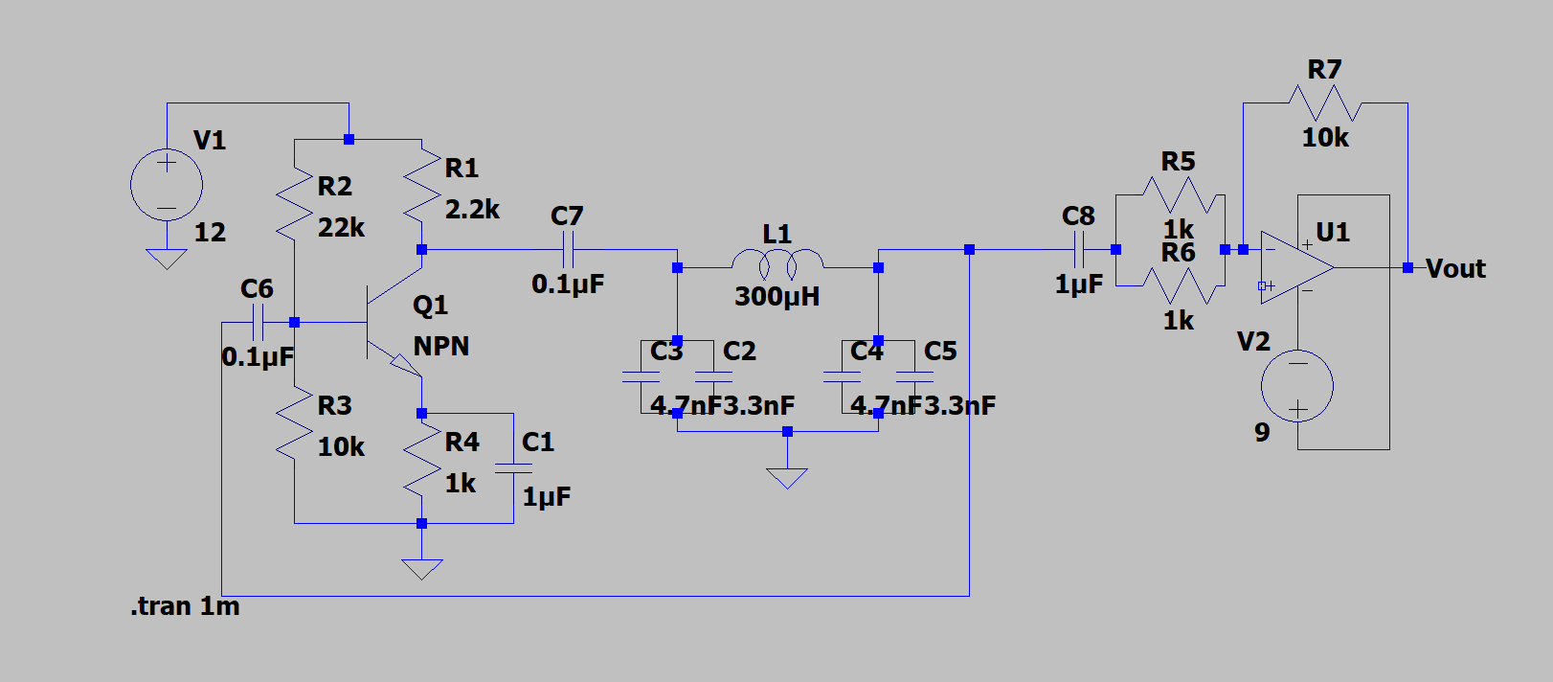
THE FINAL CIRCUIT DESIGN
The circuit was first tested on Ltspice to see the working of the oscillator.
*
Department of ECE
11

Slide 12
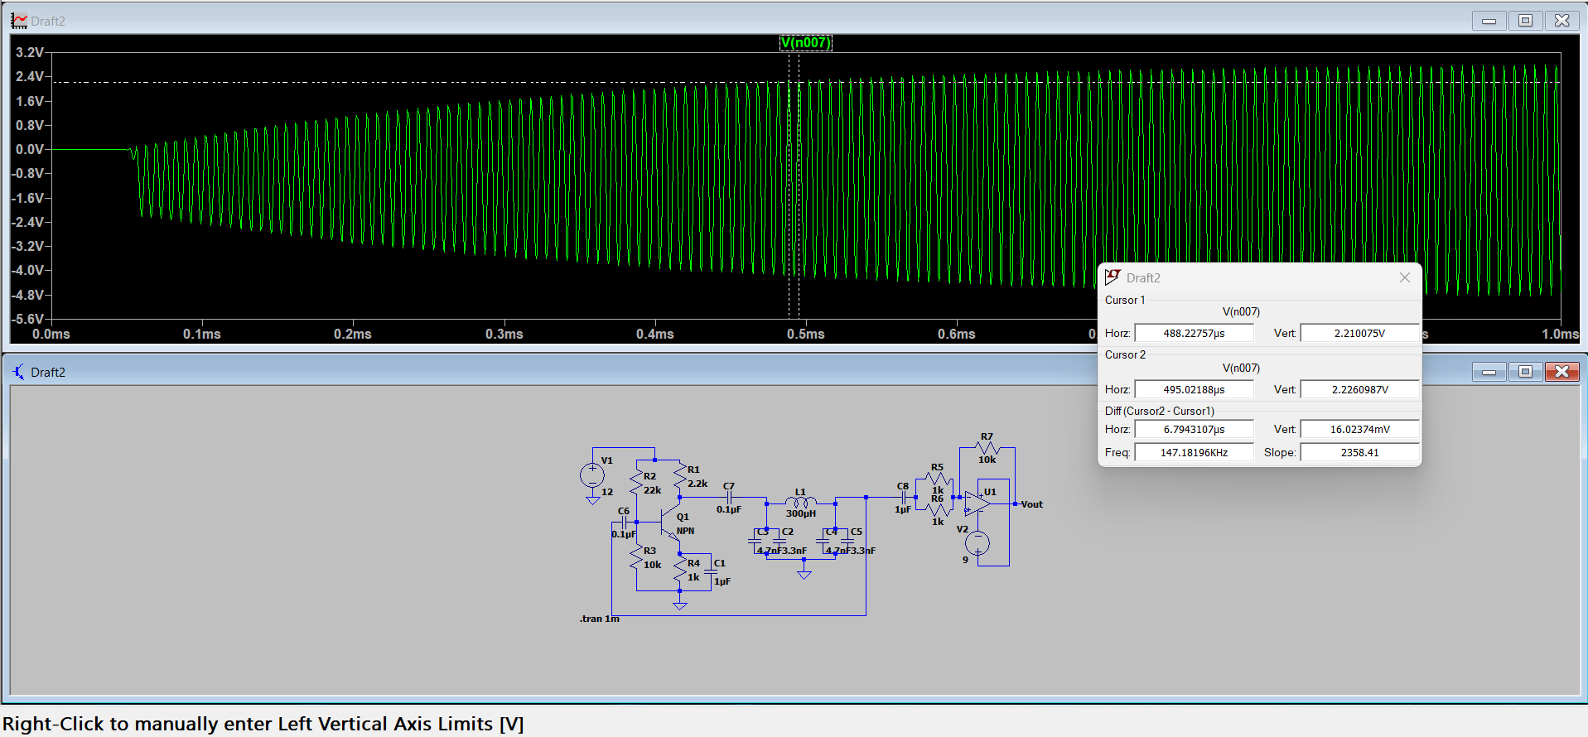
THE OSCILLATOIONS OUTPUT
The value of oscillations were verified through the output graph.
*
Department of ECE
12

Slide 13
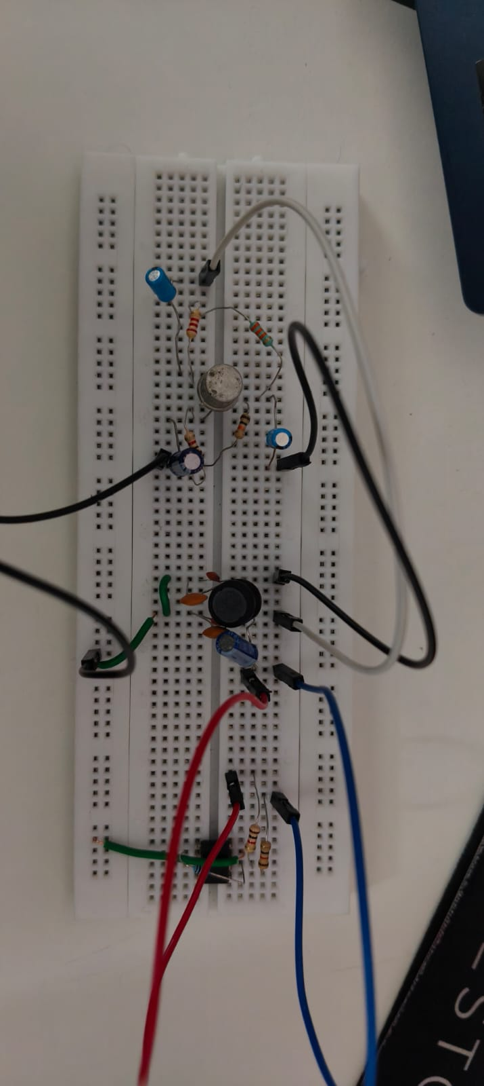
FINAL IMPLIMENTED PROTOTYPE
*
Department of ECE
13

Slide 14
DETAILS OF SOFTWARE / HARDWARE
LT-Spice Simulation Software: Used to simulate the working of the circuit before implementation.
Power Supply (DC): Used to provide the operating voltages of the transistor and op-amp
Digital Multimeter (DMM): Used to measure the biasing Voltages of the transistor, to ensure the biasing is done properly.
Breadboard: Used to assemble the test circuit.
Oscilloscope (CRO/DSO): Used to measure the output signal and its characteristics.
Function Generator: To test the working of the summer circuit.
Capacitors: to form the tank circuit and the filters for the transistor.
Inductor: the major component of the oscillator.
Resistors: for the biasing of the transistor and for the summer circuit.
Op-amp IC: LM358 and LM741 IC’s were used for the summing circuit
Jumper wires/single strand wires: for connecting all the components together
*
Department of ECE
14

Slide 15
Literature Review
Go ,Change the world
Paper / Article | Summary & Relevance
Nonlinear analysis of the Colpitts oscillator and applications to design — Maggio, De Feo & Kennedy (1999), IEEE Transactions on Circuits and Systems I: Fundamental Theory and Applications digitalcommons.memphis.edu+1 | This classic paper uses bifurcation analysis to examine how a Colpitts oscillator can operate in different regimes — nearly sinusoidal or chaotic — depending on circuit parameters. It offers deep insight into non-ideal behaviors, stability limits, and how design choices affect oscillation mode. Useful for understanding real-world behaviour, startup conditions, amplitude control, and nonlinearity — valuable for your “distortion” measurements and robust design.
A Noise‑Shifting Differential Colpitts VCO — Aparicio & Hajimiri (2002), IEEE Journal of Solid-State Circuits its.caltech.edu | This paper presents a modern, integrated-circuit version of a Colpitts oscillator (VCO), optimized for low phase-noise by employing a differential design and noise-shifting techniques. While your project is simpler (discrete LC oscillator), the concepts of noise reduction, phase noise, and design trade-offs are relevant — especially if you care about signal purity, distortion, or want to extend it toward RF/VCO designs.
Selected IEEE / Scholarly Papers on Colpitts Oscillator

Slide 16
Literature Review
Go ,Change the world
CMOS‑RC Colpitts Oscillator Design Using Floating Fractional‑Order Inductance Simulator — Kartci, Herencsar, Brancik & Salama (2018 MWSCAS / IEEE conference) faculty.kaust.edu.sa+1 | This work demonstrates a more advanced oscillator topology (fractional-order inductance simulator) allowing flexible tunability, compactness, and integration, while maintaining Colpitts-type behavior. Shows that modern design variants exist beyond discrete LC, which is useful if you later scale the project (e.g. to integrated circuits or low-voltage/low-power oscillators).
A Simulation Study Of Colpitts Oscillator Reliability And Variability — Yuan & Chen (2012), IEEE Transactions on Device and Materials Reliability stars.library.ucf.edu | This paper investigates how process variation (in CMOS implementations) affects Colpitts oscillators, using Monte Carlo simulations. It analyses phase noise and reliability under parameter variability, and proposes adaptive techniques (body-bias) to mitigate degradation. For you, it emphasizes that real-world components (tolerances, parasitics) affect oscillator performance and that simulation/study of robustness is important — which ties into comparing theoretical vs measured frequency and distortion.

Slide 17
Thank You
*
Department of ECE
17

